Slide 1

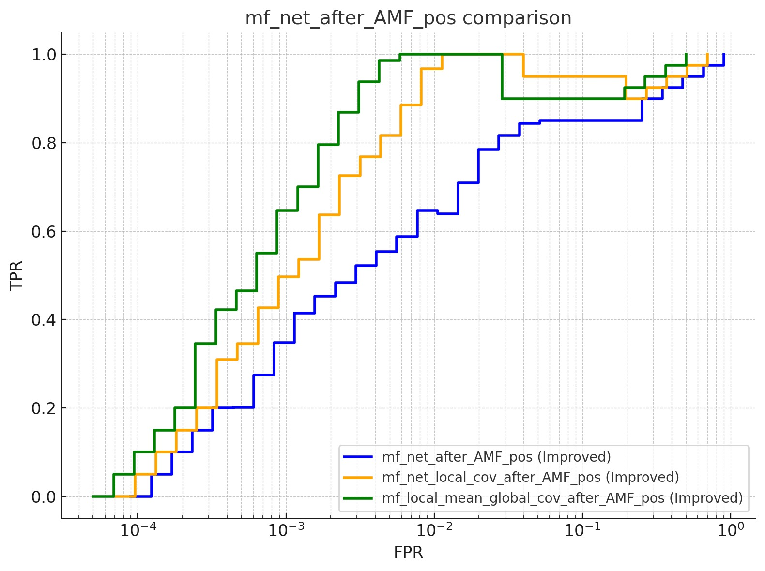
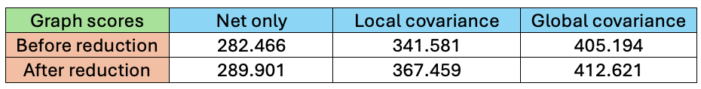
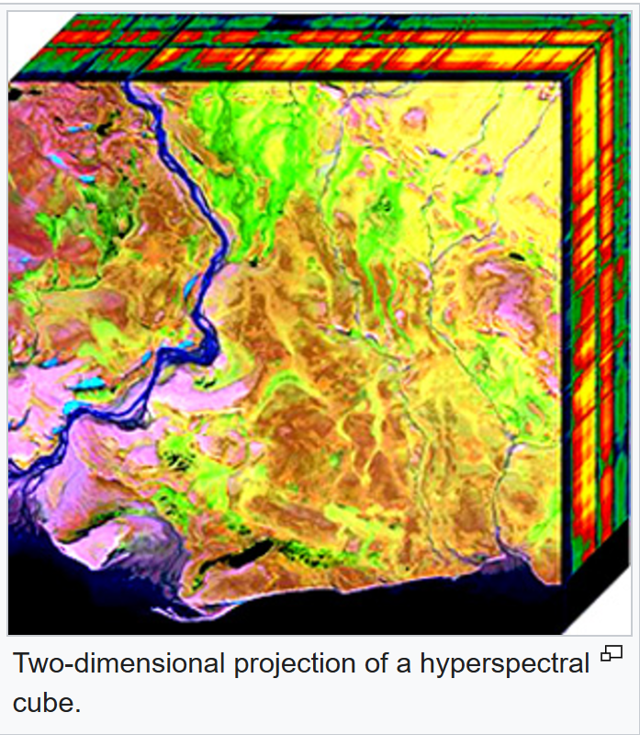
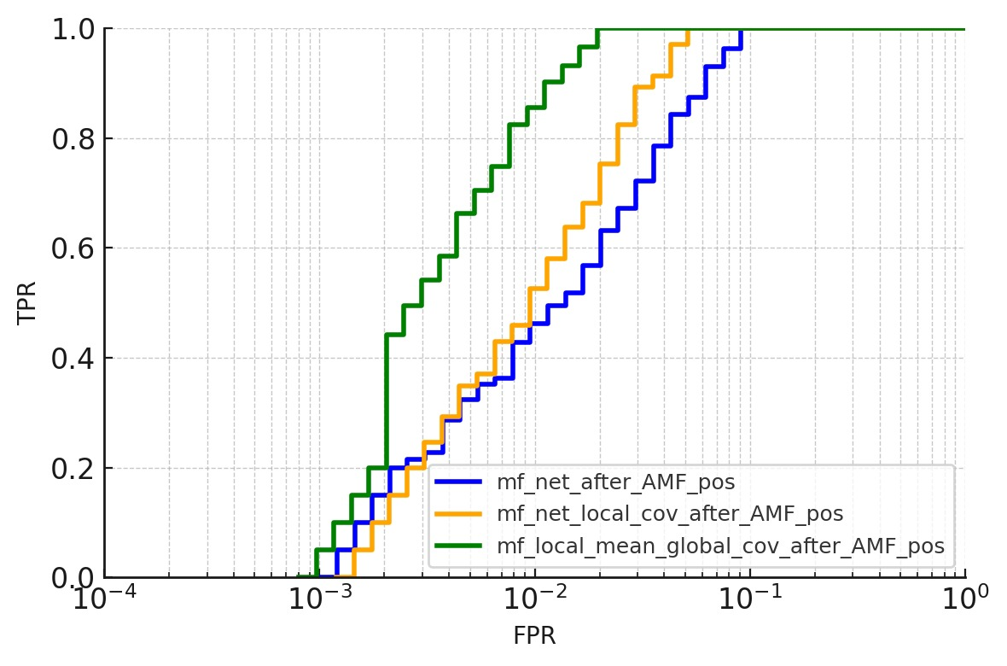
Analysis Of Hyperspectral Images
Project Number: 2965
Names: Or Mizrahi, Arie Rozental
Advisor: Khen Cohen
Introduction This project focuses on the development and implementation of a system for identifying objects in hyperspectral images, for the use of classified security technologies. The system uses the unique data found in hyperspectral images to identify important and significant objects within various uses, such as identifying objects located in places that are not visible to the eye, and identifying different types of materials. A hyperspectral image is an image taken with a hyperspectral camera, that captures a wide range of wavelengths more than what the human eye can see. Typically, hyperspectral images cover a range of 400–2500 nm, with a high spectral resolution that allows the wavelengths to be divided into many channels (tens to hundreds). Hyperspectral imaging collects and processes information from across the electromagnetic spectrum. The goal of hyperspectral imaging is to obtain the spectrum for each pixel in the image, with the purpose of finding objects, identifying materials, or detecting processes. | Implementation Results We were able to perform detection by estimating a local mean and a local covariance matrix, with high accuracy, in a certain channel range, and not in the entire hyperspectral channel range. We discovered that discarding noisy and redundant channels can improve the scores of our detection. The next graph is before the reduction of any channels: | And now, after removing the unwanted channels. Conclusions Performing object detection by hyperspectral images, works well within a certain range of channels, but lacks outside this range. Bibliography [1] Tzvi Diskin and Ami Wiesel, “Self-Supervised Learning for Covariance Estimation”, The Hebrew University of Jerusalem, 13 March 2024. [2] Hyungtae Lee, Member, and Heesung Kwon, “Going Deeper with Contextual CNN for Hyperspectral Image Classification”, 9 May 2017. [3] Shengjie Liu, and Qian Shi, “Multitask Deep Learning with Spectral Knowledge for Hyperspectral Image Classification”, 26 Dec 2019.
Taking a hyperspectral image
Initial image processing
Neural Network
Estimation of Mean and Covariance Matrix of the Image
Detection algorithm
Algorithm returns the accuracy in detection
Two-dimensional projection of a hyperspectral cube

